Slide 1
UCN Fund for
Social Justice
2001 - Present

Slide 2

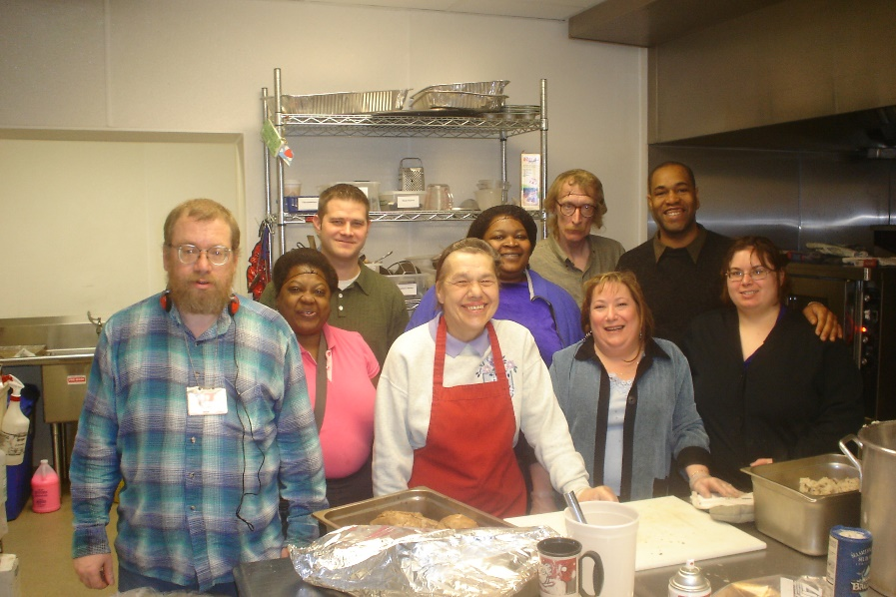
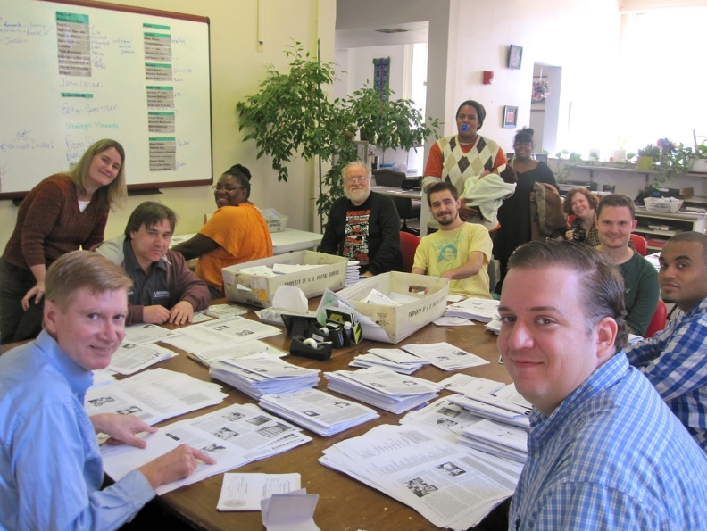
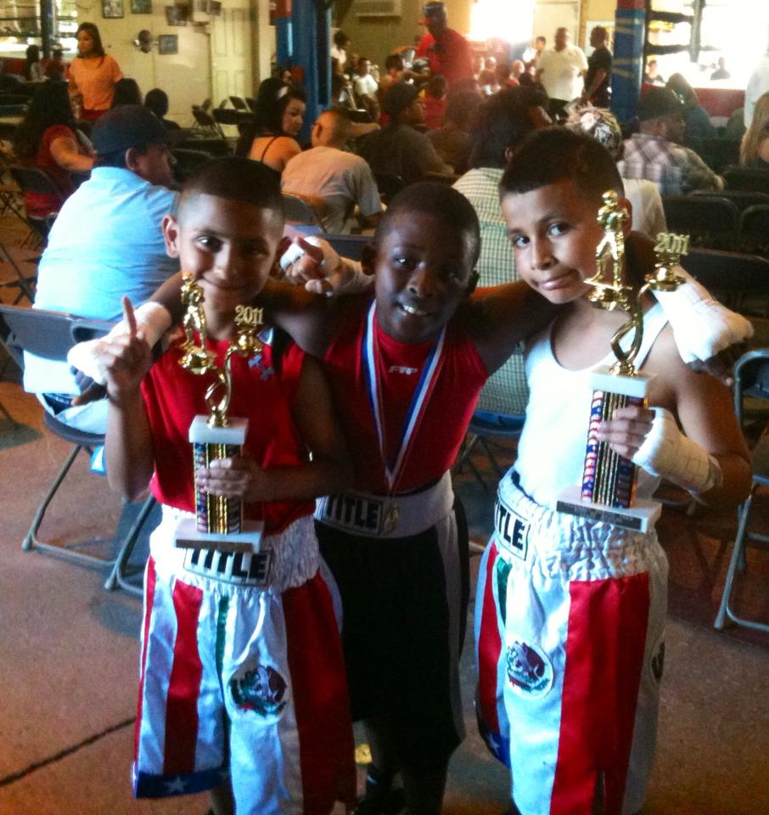
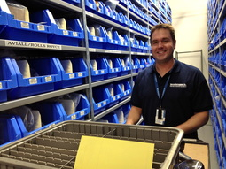
2001 Award: $410.00

Slide 3


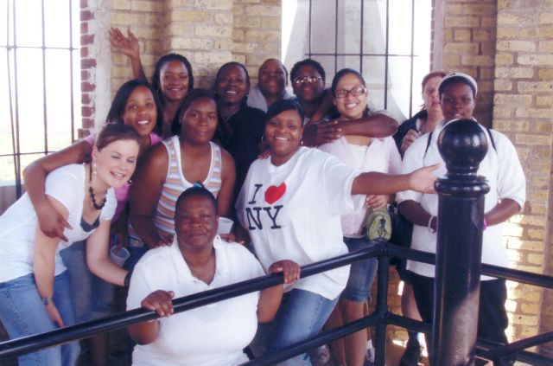
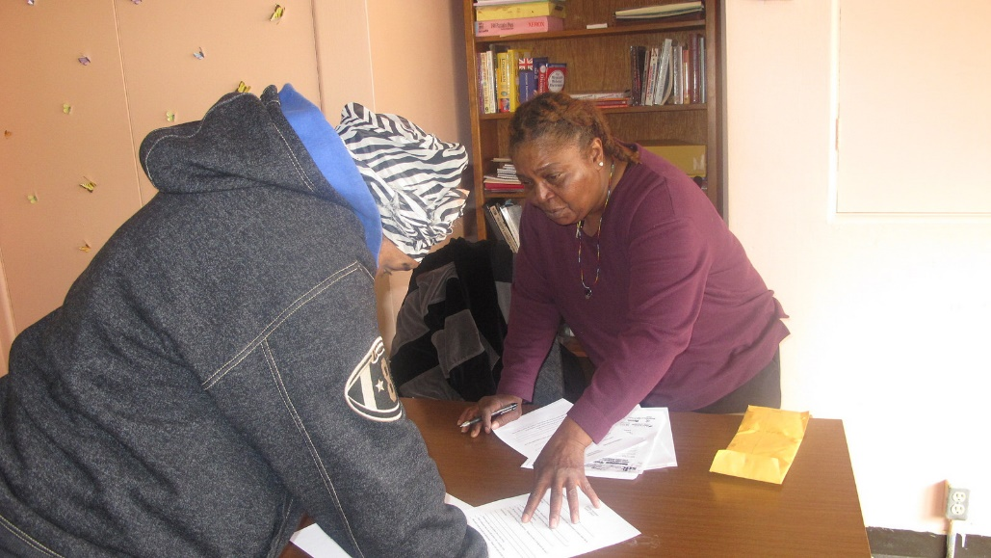
2002 Award: $649.11

Slide 4




2003 Award: $320.94

Slide 5

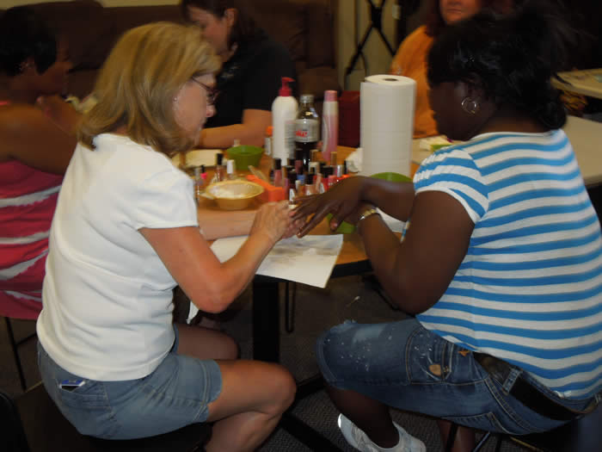

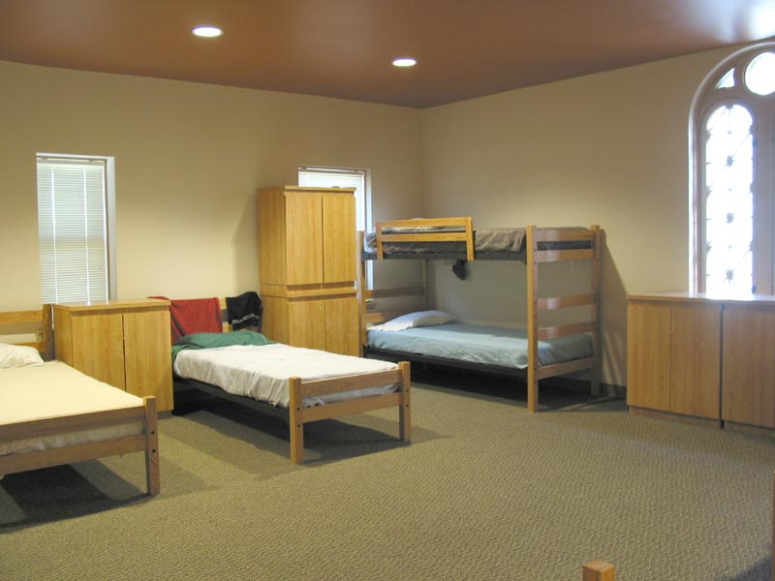
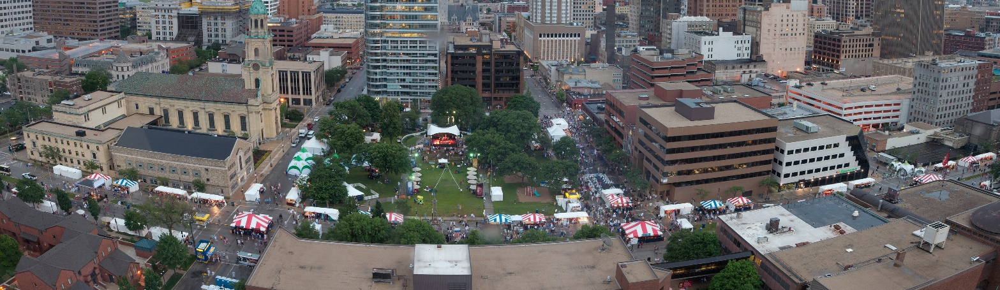
2003 Award: $500.00

Slide 6
2004 Award: $895.44

Slide 7

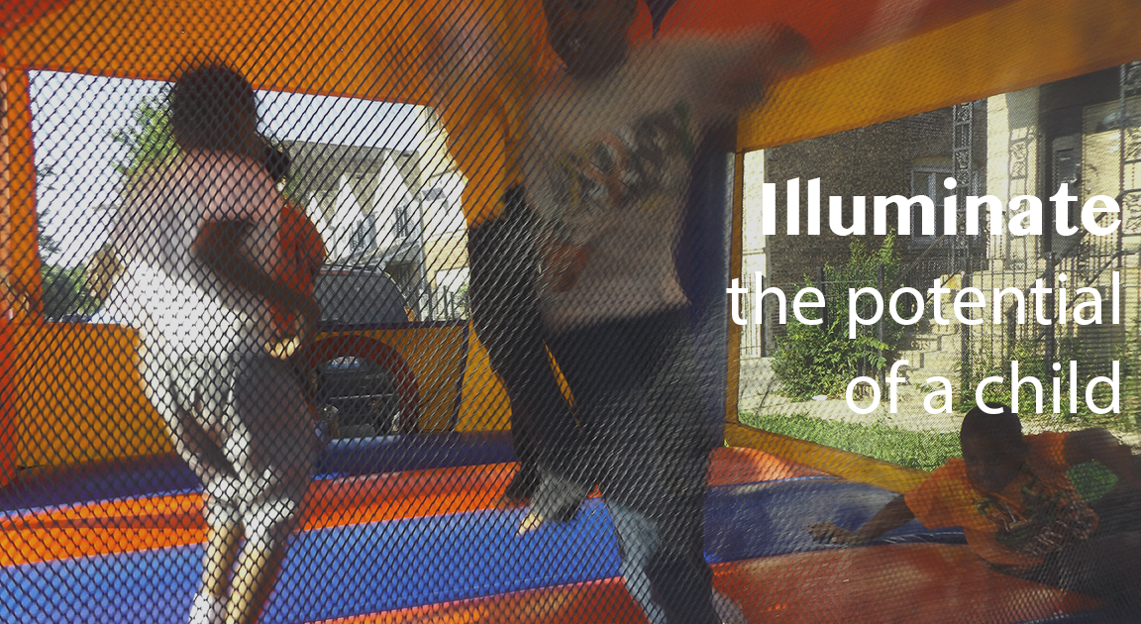
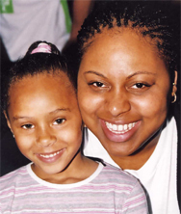
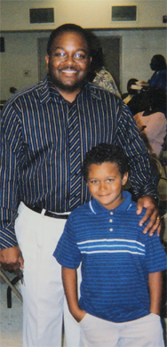
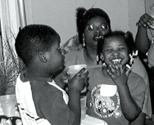
Amachi Program of
Big Brothers/Big Sisters
2005 Award: $863.59

Slide 8


2006 Award: $698.55

Slide 9


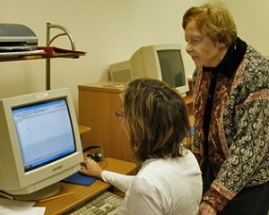
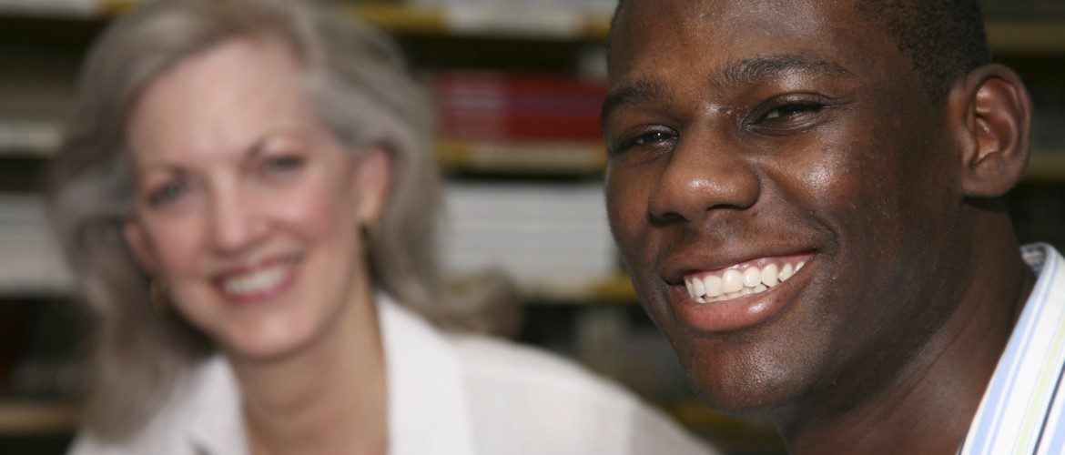
2007 Award: $250

Slide 10


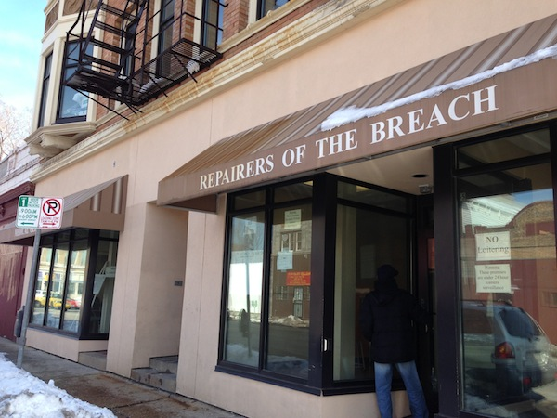
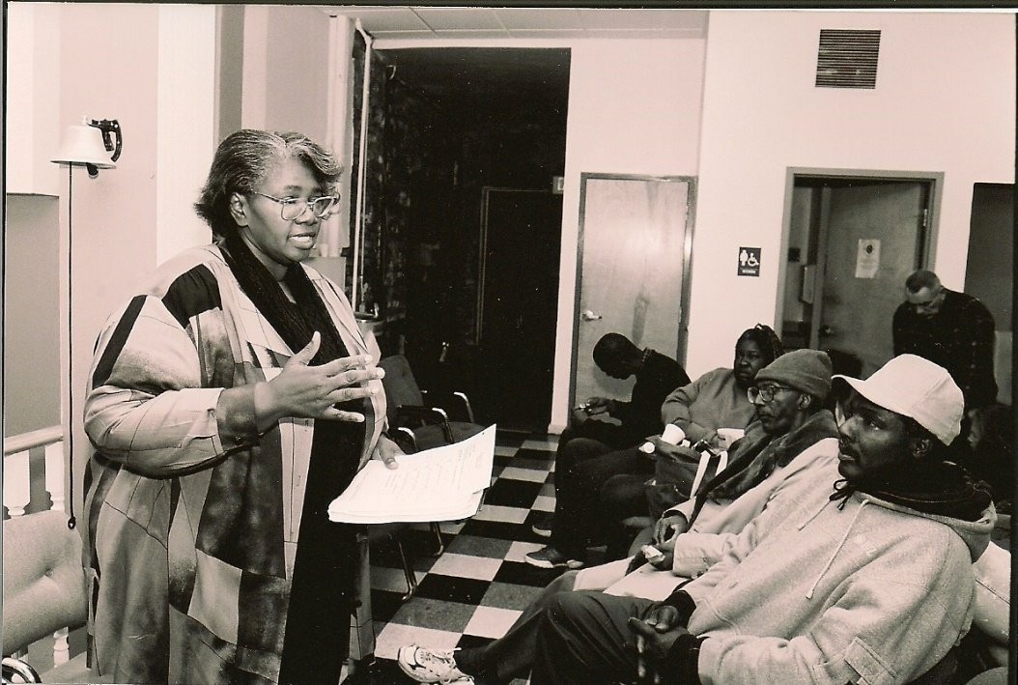
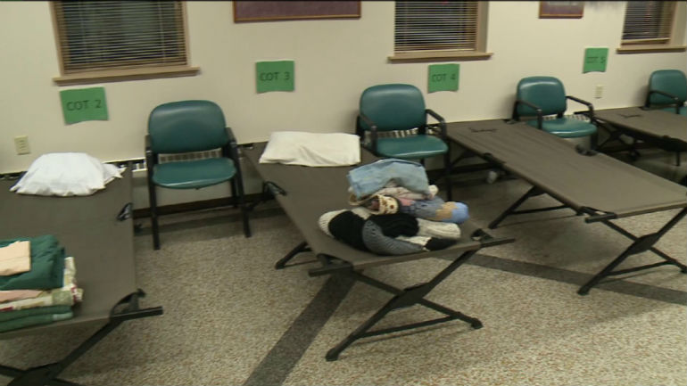
2007 Award: $428.79

Slide 11

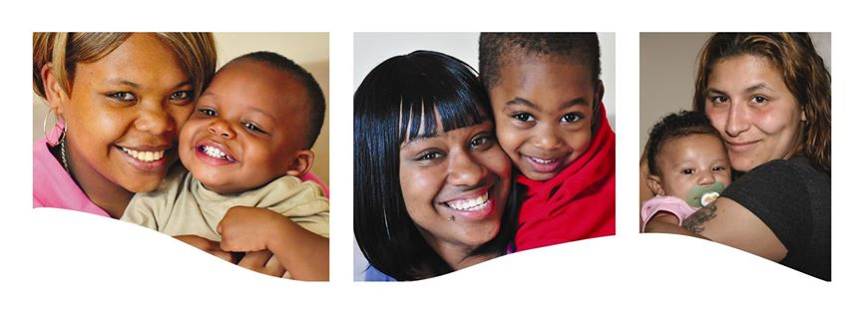


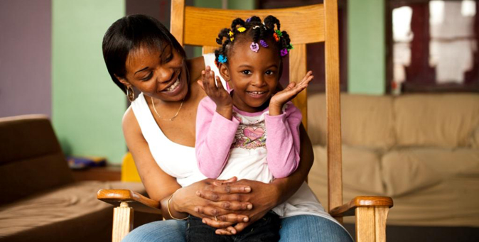
2008 Award: $680.29

Slide 12
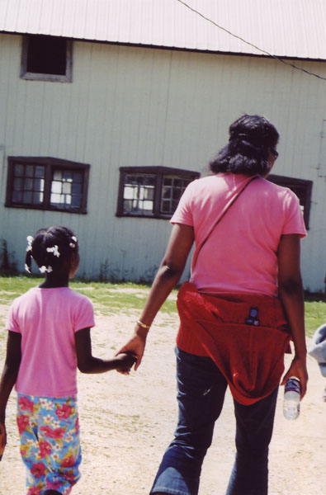

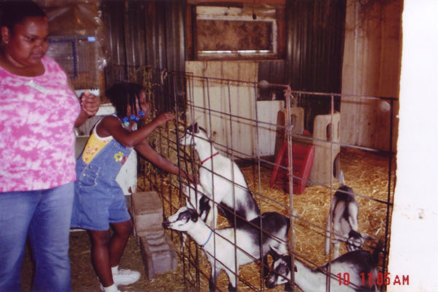
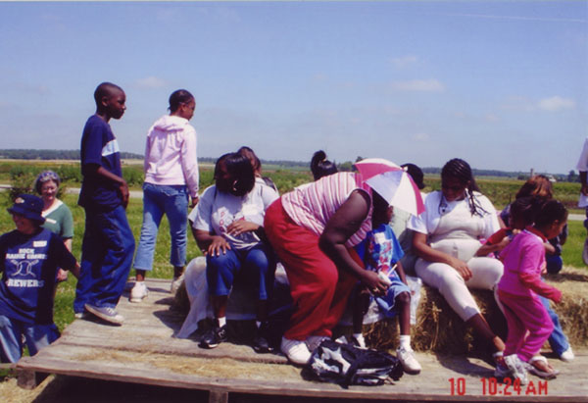
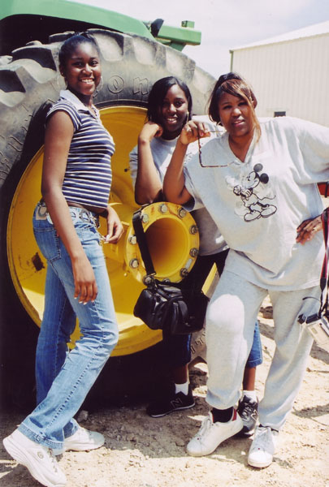
2009 Award: $729.00

Slide 13
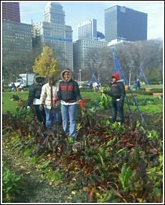
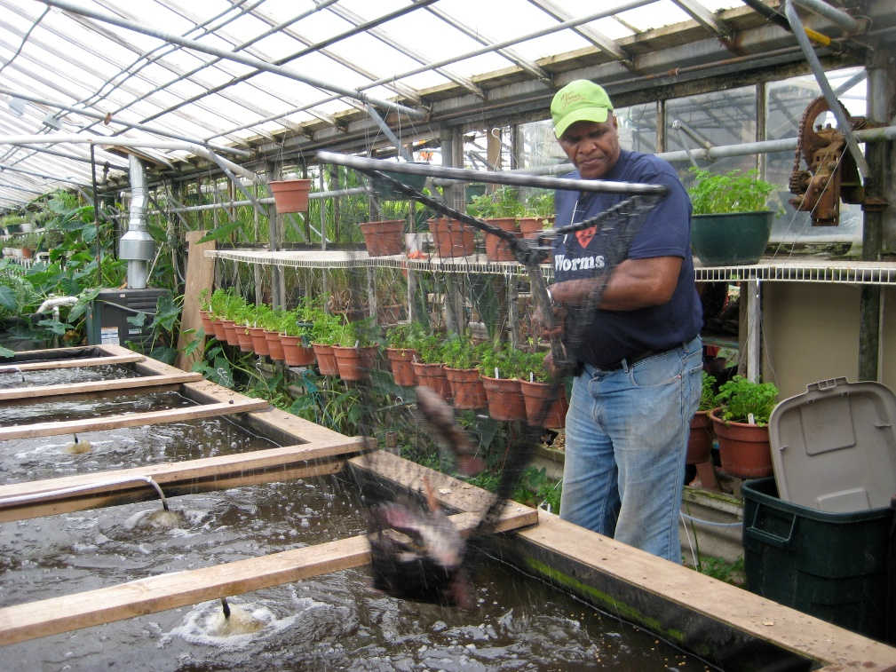

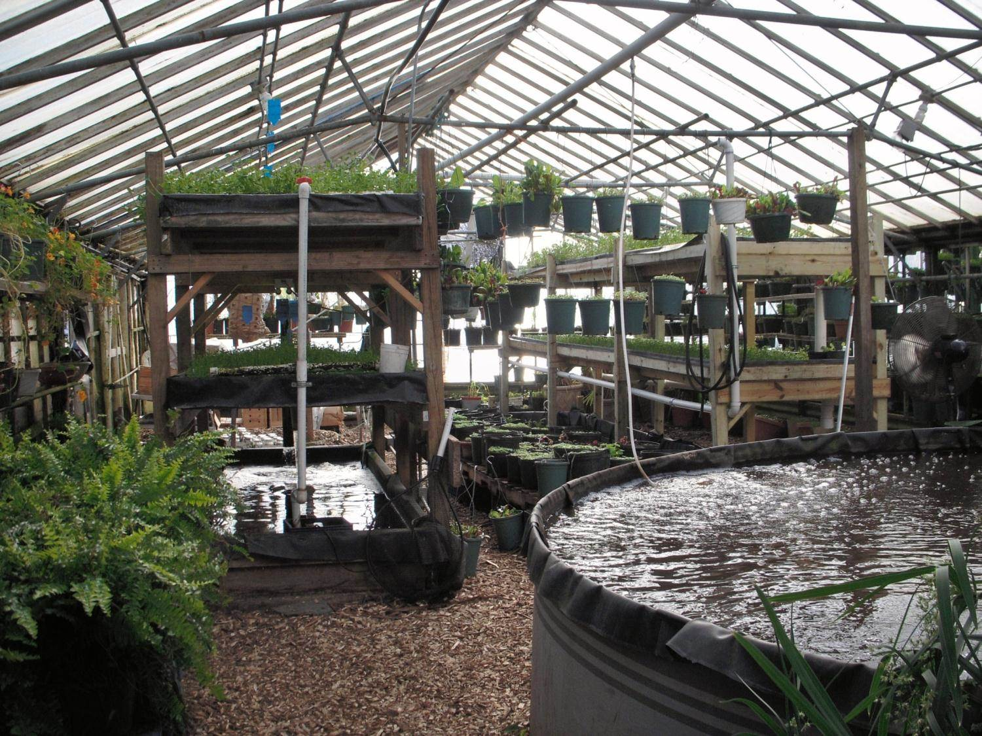
2010 Award: $786.94

Slide 14

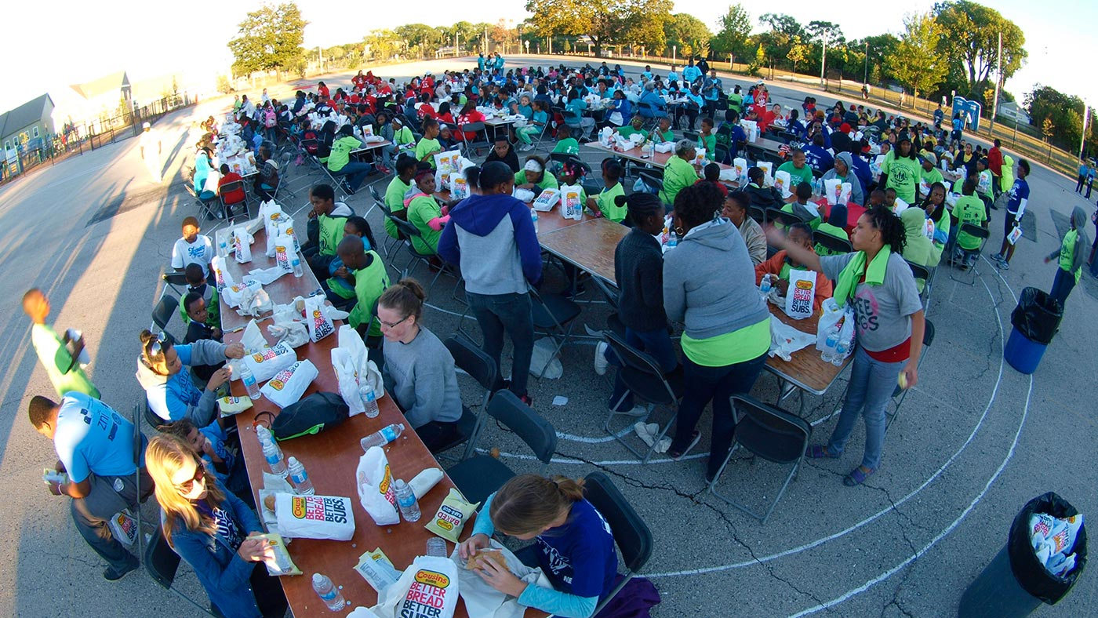
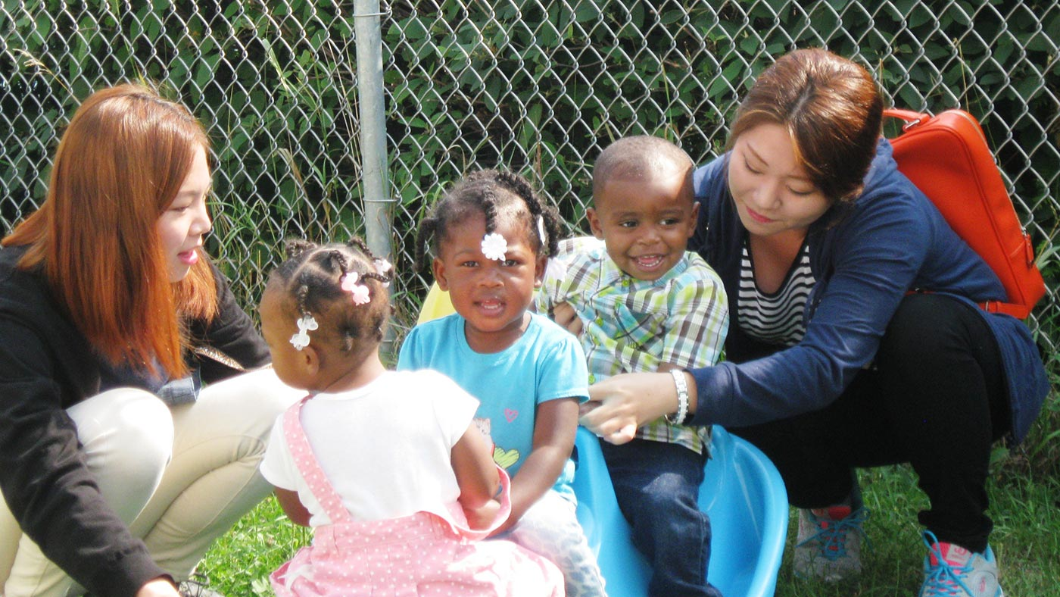
2011 Award: $755.81

Slide 15

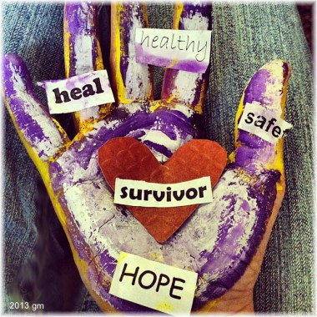
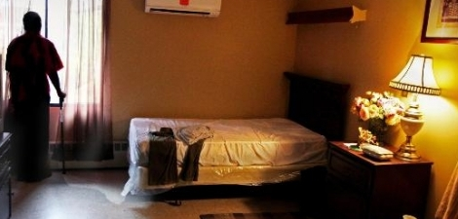
2012 Award: $744.00

Slide 16

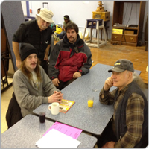
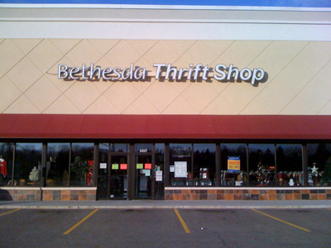
2013 Award: $709.44

Slide 17
2014: $0
No Nominations were Received!
ANY UCN member may nominate an organization for consideration.
Find the nomination form at ucnorth.org, Social Justice, or pick up one from the upstairs lobby.
Complete and hand in the nominating paperwork to UCN’s office by January 15.

Slide 18

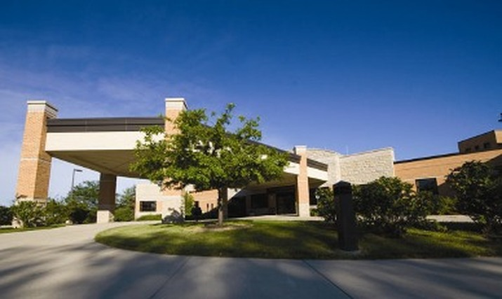
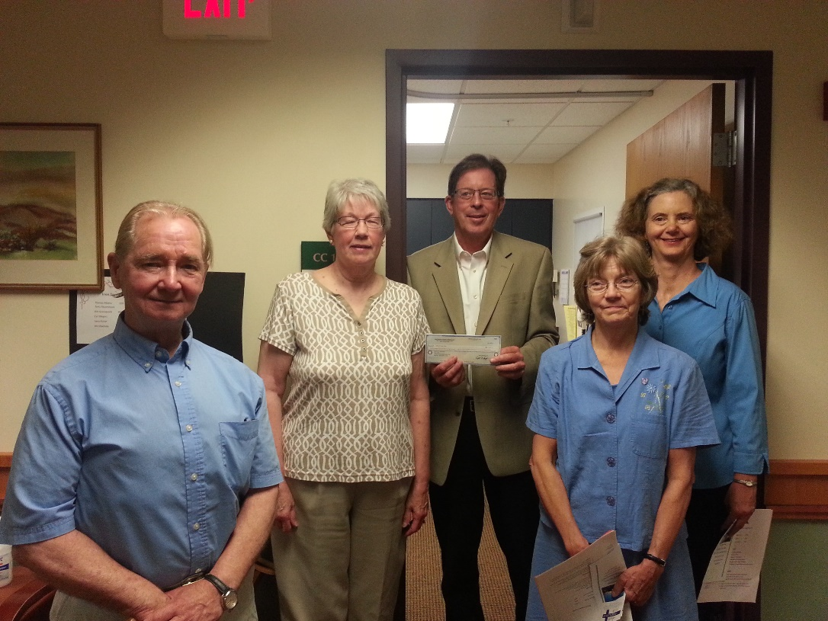
2015 Award: $1,421.11

Slide 19


2016 Award: $729.28

Slide 20

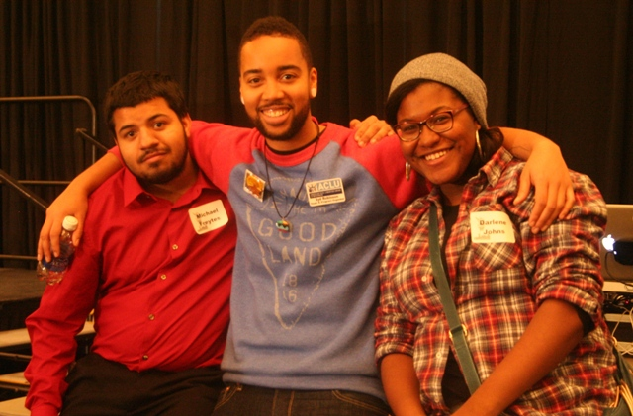
AMERICAN CIVIL LIBERTIES UNION
STUDENT ALLIANCE
2017 Award: $767.00

Slide 21





2018 Award: $787.52

Slide 22



Milwaukee Inner City Congregations Allied for Hope
2019 Award: $806.32

Slide 23
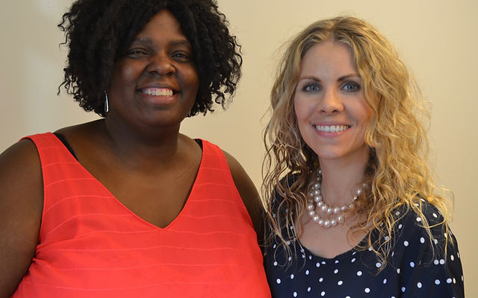


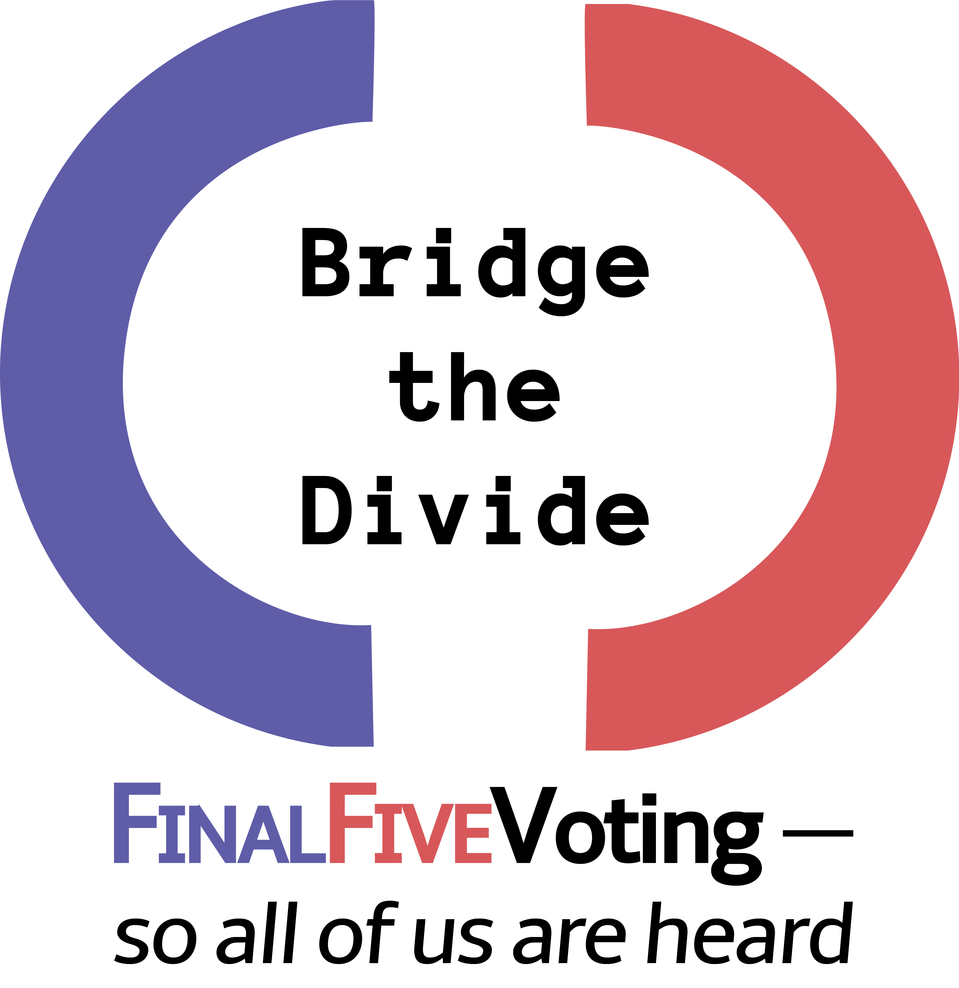
Bridge the Divide, Cedarburg
2020 Award: $841.14

Slide 24


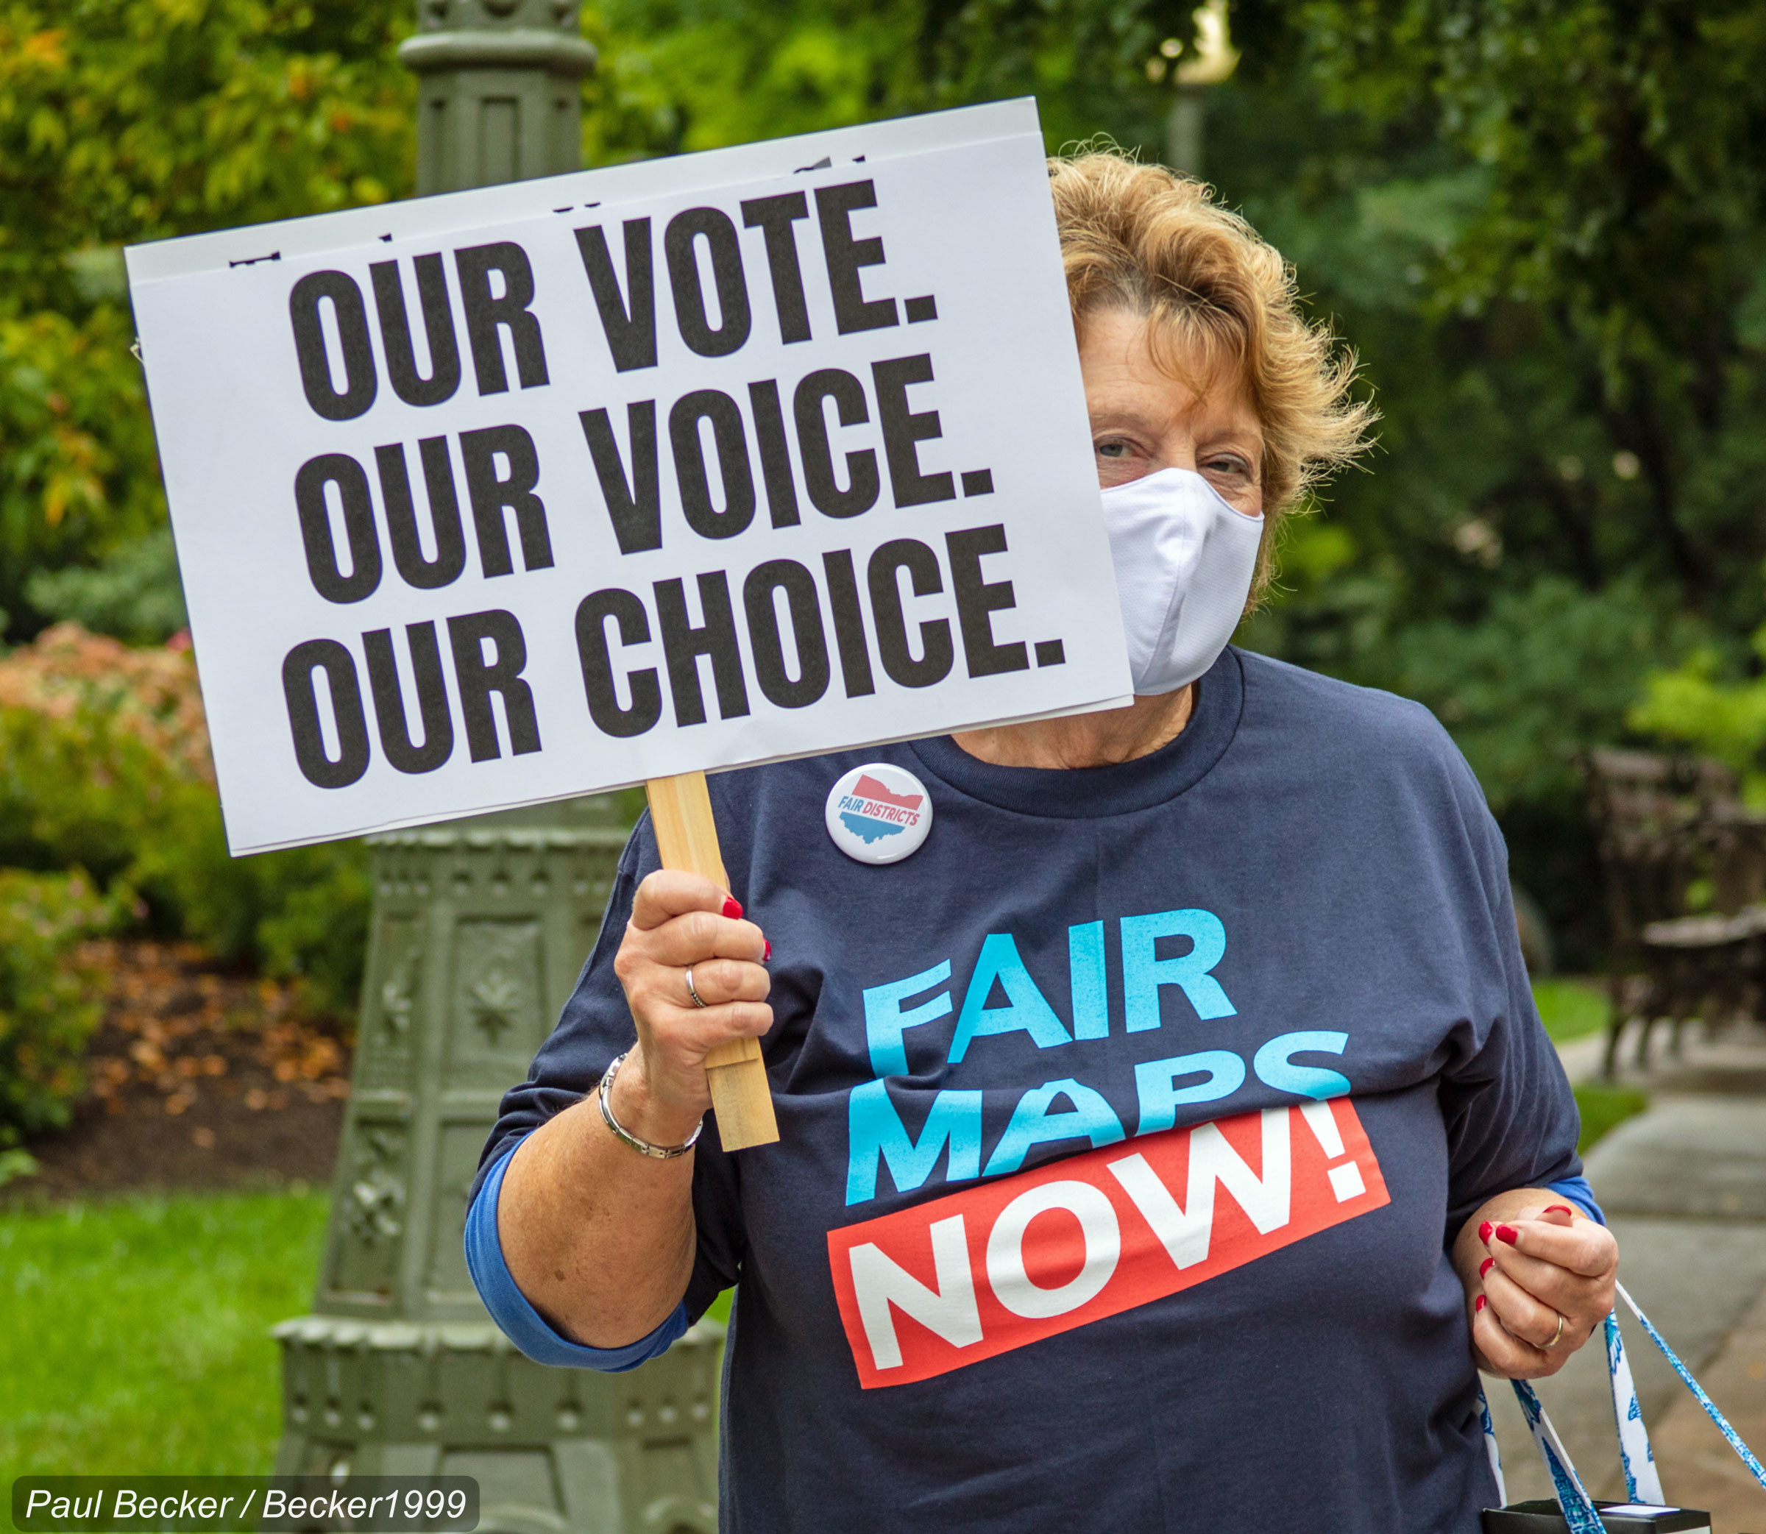
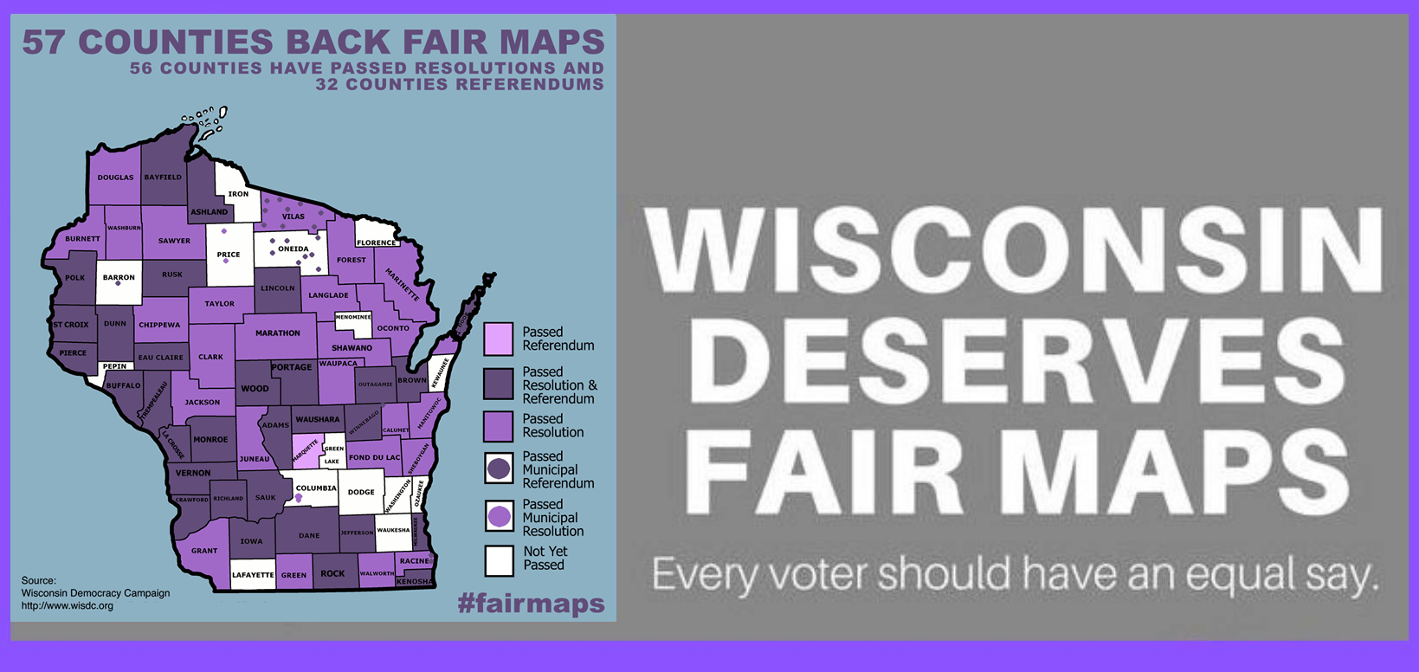
Wisconsin Fair Maps Coalition
2021 Award: $869.33

Slide 25



2022 Award: $922.42

Slide 26
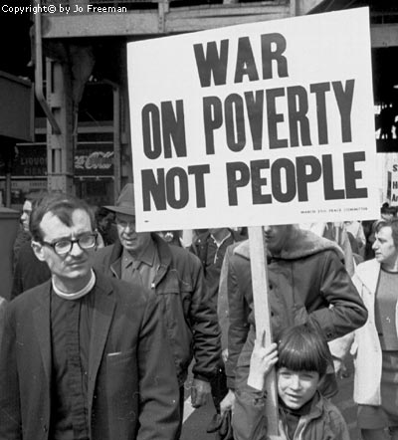
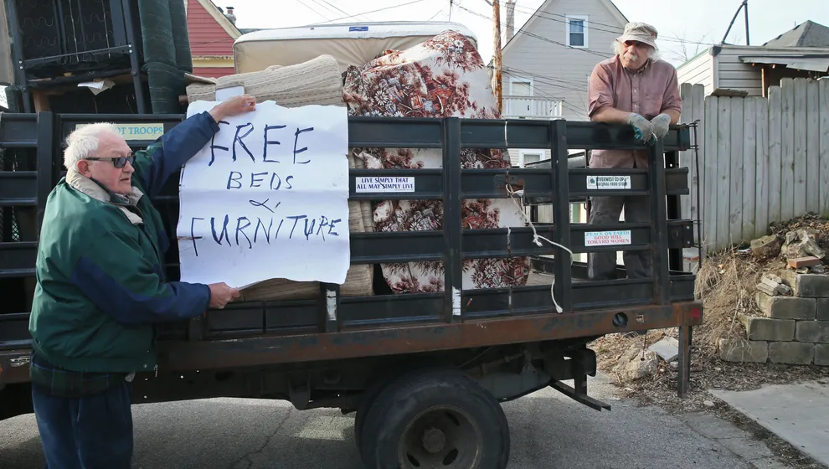
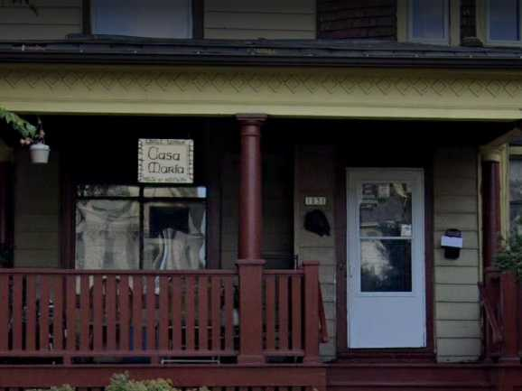
Casa Maria Catholic Workers, Milwaukee Chapter
2023 Award: $967.68

Slide 27

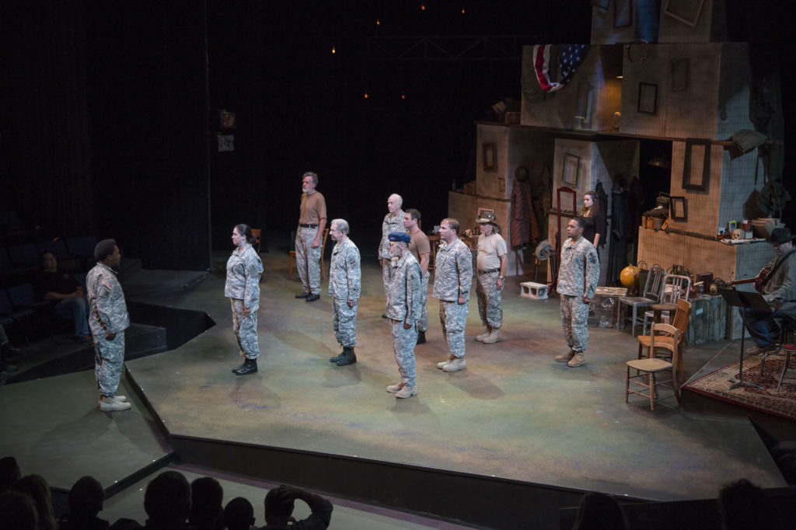

2024 Award, $1,036.31

Slide 28
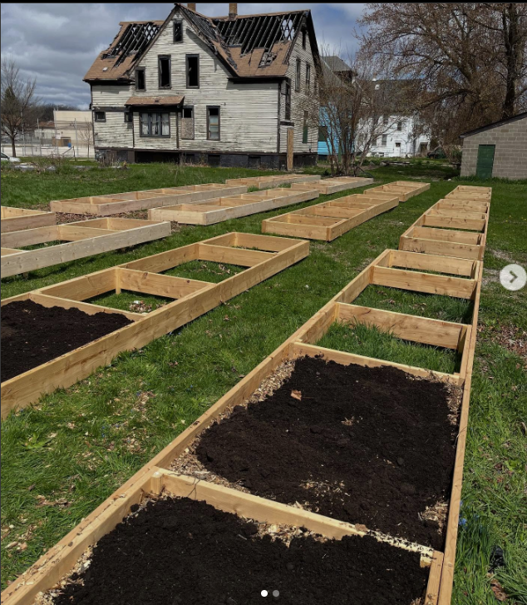
We Got This Community Garden
Milwaukee
$1,234.50
2024 Award

Slide 29

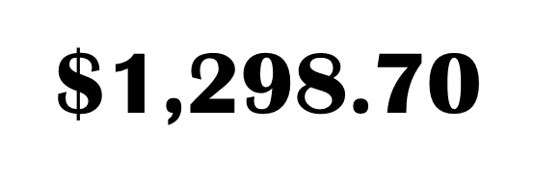
Hunger Task Force of Milwaukee
2025 Award

